Slide 1
Interpretability Beyond Feature Attribution: Quantitative Testing with Concept Activation Vectors (TCAV)
Kim et al. (2018)
Presented by Lucia Gordon, Matthew Nazari, Catherine Yeh
Notes:
Roadmap of different classes of methods to give big picture: users can define concepts of interest and see how much they matter Gradient → Attention → Concept Based

Slide 2
Thoughts on Concept-Based Explanations So Far?
Notes:
High level question at beginning: e.g., So previous approach (network dissection) was “concept based,” how many people would use it real world?
Or how many would prefer over the attention approaches from last class? Which one is more promising

Slide 3
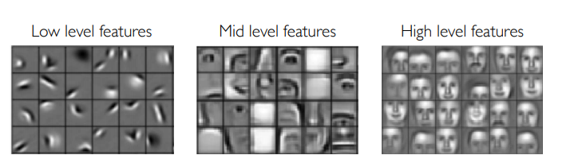
Motivation + Problem Statement
Interpreting deep learning models is crucial to understanding their behavior, ensuring accurate predictions, and reflecting our values
But remains a big challenge due to size, complexity, and opacity of ML models
Additionally, many systems operate on low-level features (e.g., pixel values) rather than high-level concepts (e.g., face) that are human-interpretable
Notes:
As well as helping develop, debug, and design models
The internal values of models (e.g., the neural activations) are also not easily understood

Slide 4
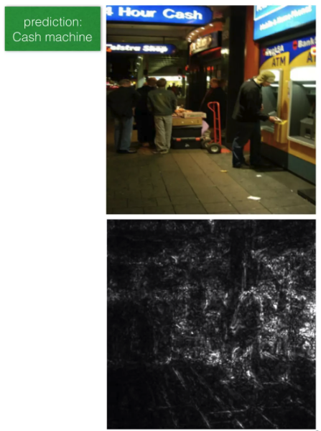
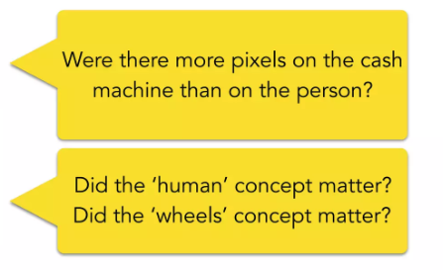
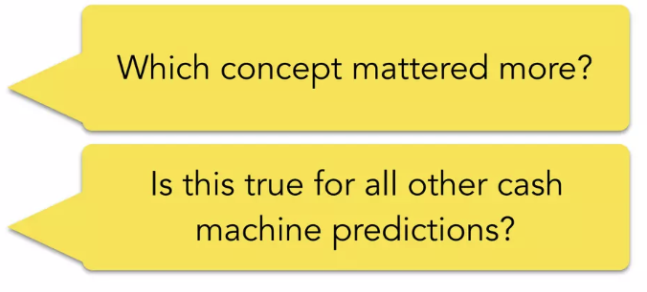
Motivation + Problem Statement
Problem:
We can’t express these concepts as pixels
And they weren’t our input features
Image from Been Kim
Notes:
As we’ve seen before, saliency maps are a popular method for assigning importance weights to pixels based on first-order derivatives
So if we want to understand the model’s prediction here, we might take a look at this saliency map and ask questions like
Human and wheel kind of bright for some reason
So methods that describe model predictions in terms of its input features like saliency maps won’t work in this case

Slide 5
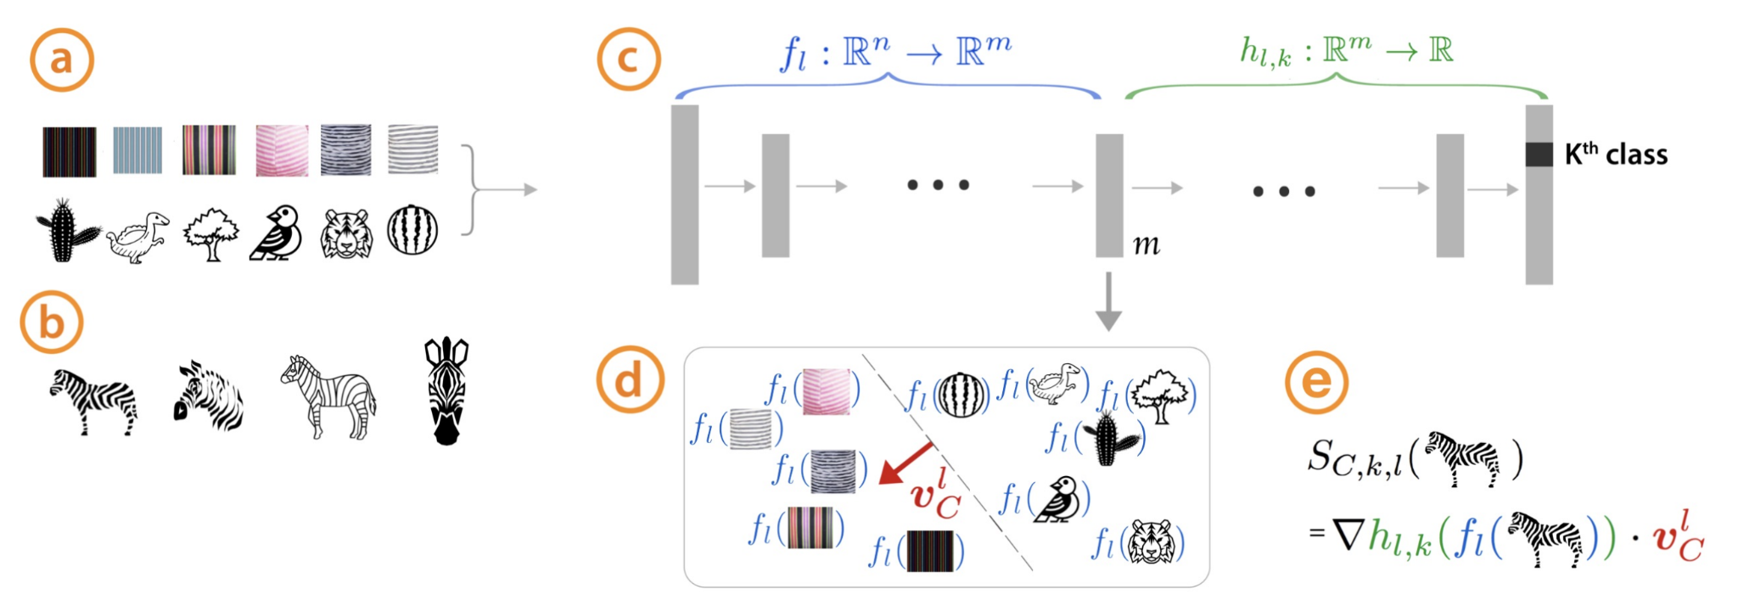
Summary of Contributions
Introduce Concept Activation Vectors (CAVs): way to interpret a neural network’s internal state in terms of human-friendly concepts
Key idea is to use the high-dimensional internal state of a neural net as an aid not an obstacle
Main contribution is a new linear interpretability method, Testing with CAV (TCAV), that quantifies model sensitivity to a high-level concept learned by a CAV for a particular class
E.g., “striped”
E.g., “zebras”
Notes:
users can define concepts of interest
CAV for a concept = vector in the direction of the values (e.g., activations) of that concept’s set of examples

Slide 6
Goals of TCAV
Accessibility: requires little to no ML expertise
Customization: adaptable to any concept, even outside of training
Plug-in readiness: works without retraining/modifying ML models
Global quantification: can interpret entire classes with a single quantitative measure
Assessed with experiments + human evaluation
Notes:
Accessibility: Requires little to no ML expertise of user.
Customization: Adapts to any concept (e.g., gender) and is not limited to concepts considered during training.
Plug-in readiness: Works without any retraining or modification of the ML model.
Global quantification: Can interpret entire classes or sets of examples with a single quantitative measure, and not just explain individual data inputs.
Looked at standard image classification & medical application, also do a crowdsourcing experiment to compare TCAV to feature-based explanations

Slide 7
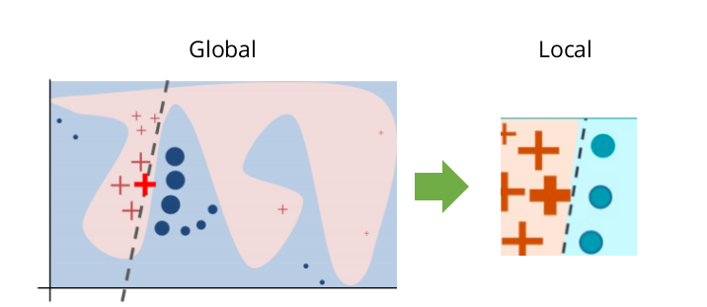
Related Work
Interpretability methods:
Inherently interpretable models vs. post-hoc explanations
(Goodman & Flaxman, 2016)
(Kim et al., 2014; Doshi-Velez et al., 2015)
Perturbation-based methods: e.g., LIME/SHAP
local vs. global
(Ribeiro et al, 2016; Lundberg & Lee, 2017)
Notes:
They motivate the growing need for post-hoc methods that can be applied without retraining/modifying networks
But discuss that a key challenge is making sure that the explanation correctly reflects the model’s complex internals
Use generated explanation as input and check network’s output for validation; commonly done through perturbation-based methods like LIME/SHAP where data points or features can be perturbed
. They maintain the consistency either locally (i.e., explanation is true for a data point and its neighbors) or globally (i.e., explanation is true for most data points in a class)
The authors note that even perturbation based methods can be inconsistent if the explanation is local, so TCAV offers more global explanations that are true for entire classes of points

Slide 8
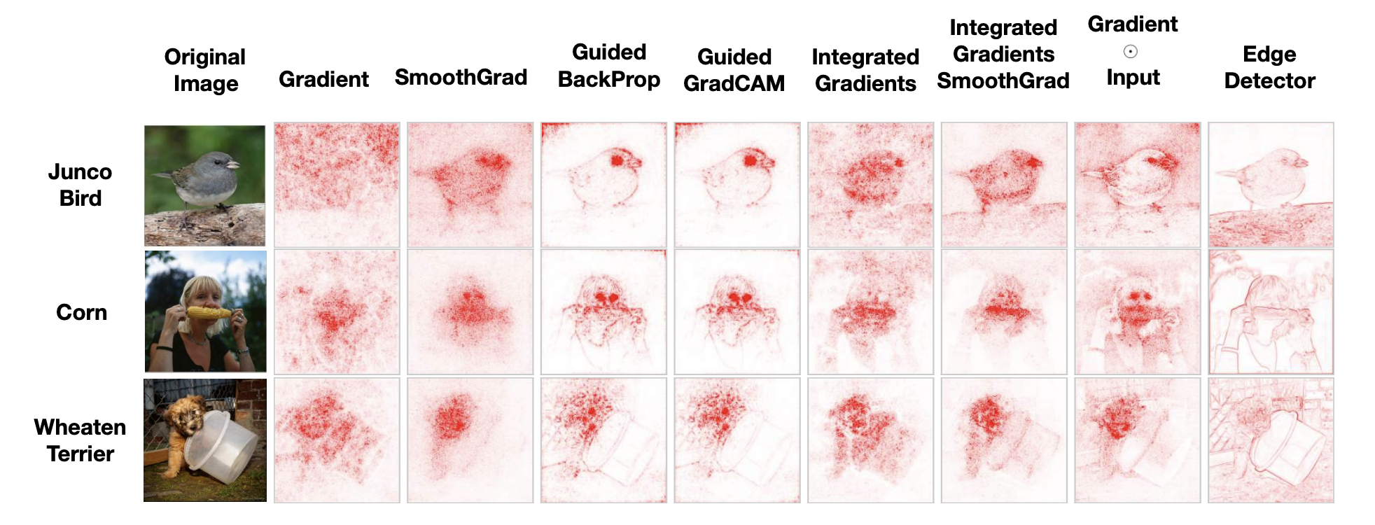
Related Work
Interpretability methods in neural networks
Limitations w/ saliency methods
Local explanation
Lack customization
Vulnerable to adversarial attacks
Insensitivity to randomization
(Erhan et al., 2009; Smilkov et al., 2017)
(Ghorbani et al., 2017)
(Adebayo et al., 2018)
Notes:
1) since a saliency map is given conditioned on only one picture (i.e., local explanation), humans have to manually assess each picture in order to draw a class-wide conclusion, and 2) users have no control over what concepts of interest these maps pick up on (lack of customization).
Saliency maps may also be vulnerable to adversarial attacks
some recent work has demonstrated that saliency maps produced by randomized networks are similar to that of the trained network (Adebayo et al., 2018),

Slide 9
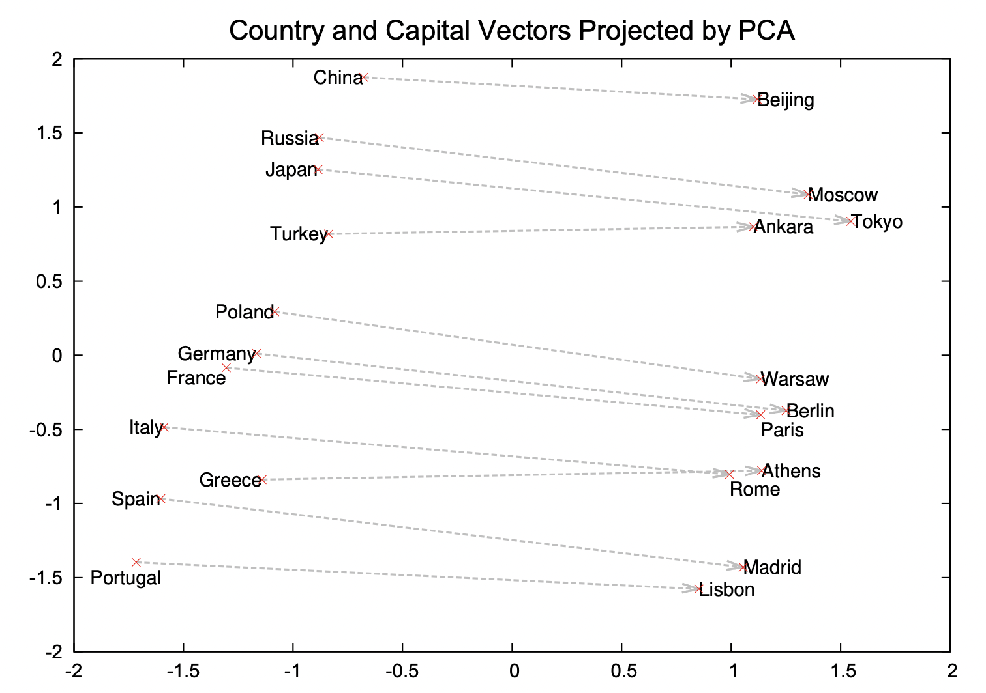
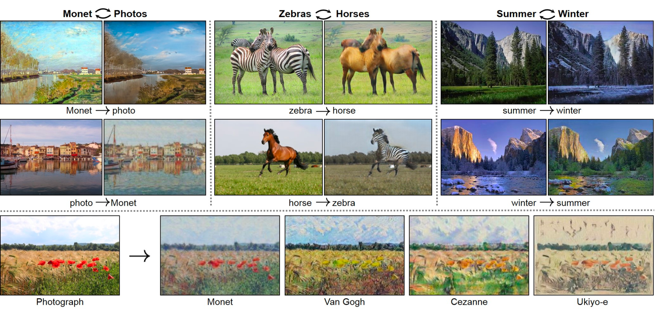
Related Work
Linearity in neural network + latent dimensions
Meaningful information can be learned from simple linear classifiers
(Bau et al., 2017; Alain & Bengio. 2016)
Mapping latent dimensions to human concepts
(Mikolov et al., 2013; Zhu et al., 2017)
word2vec
cycleGAN
Notes:
Combines these two ideas
linear combinations of neurons may encode meaningful, insightful information and meaningful directions can be efficiently learned via simple linear classifiers
GANs, words, generative models
TCAV extends this idea and computes directional derivatives along these learned directions in order to gather the importance of each direction for a model’s prediction.

Slide 10

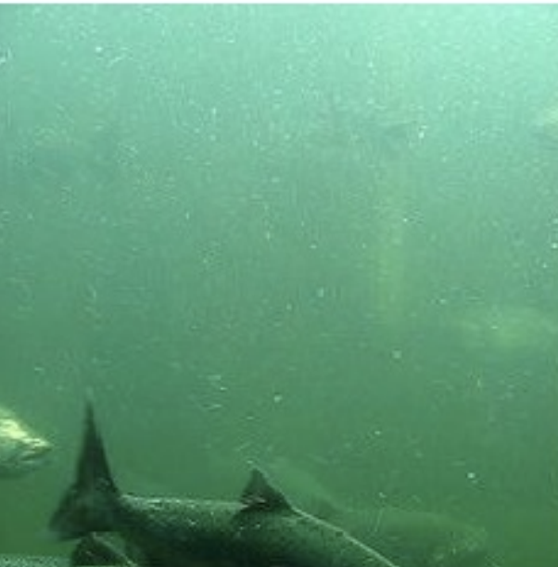
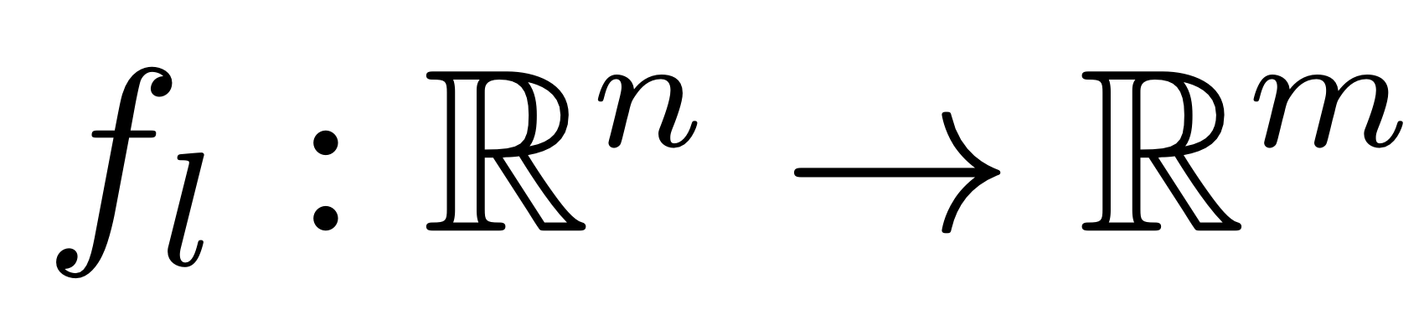



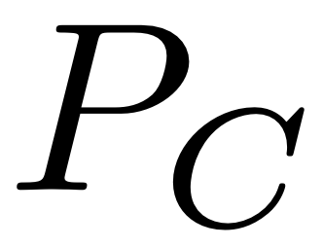
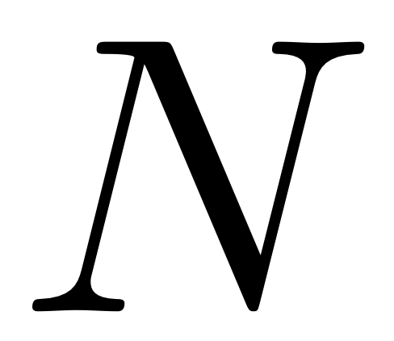


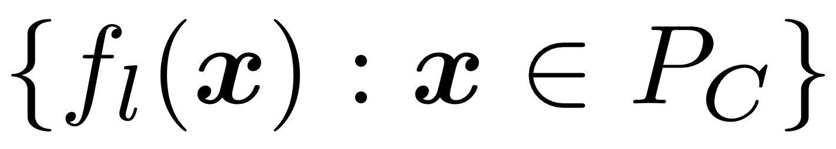
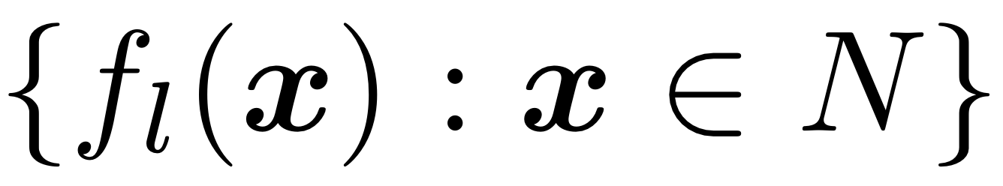
Approach: Defining the CAV
Consider the fully connected layer and the concept of interest
Collect a set of examples of that concept and a negative set of examples that don’t
Define the CAV to be a vector orthogonal to a decision boundary between activations and
Stripes
Not stripes
Notes:
a) how to use directional derivatives to quantify the sensitivity of ML model predictions for user-defined concepts,
And 2) compute a final explanation of the relative importance of each concept on the model prediction class
Let’s assume we are dealing with a neural network. We will need to refer to the layer L and a concept C.
This concept is completely user-defined by selecting a set of examples or images of the concept and a negative set of things that are not of this concept. It is worth noting that this approach does not limit the defining of a concept to engineers, as a normal person can go in and create these sets. It is also worth noting that this does not limit the concept to being something that exists or is represented within the data we plan to train on.
Next what we do is we try to seek a vector in the space of activations of layer y that represent the concept. We call this the “concept activation vector”, hence CAV, and define it to be normal to any hyperplane separating examples with concepts and without concepts. This approach has efficient implementation complexity because solving for such. Vector is equivalent to training a binary linear classifier distinguishing between layer activations of the two sets.
Here is a visualization of the CAV.
With this CAV, we can gauge the conceptual sensitivity of our model with respect to a concept at any given neural activation layer. Consider, very briefly, saliency maps, which gauge the sensitivity of the the output class k to changes in the magnitude of each pixel. This paper instead gauges sensitivity to model predictions towards a concept by measuring a single score per datapoint. In other words, we are calculating a per-concept metric, not a per-feature metric.
We now can consider Testing with CAVs, or TCAV, which according to the team working on this paper felt like a major contribution at the time, but in hindsight what we’ve covered so far of the approach was more important.
TCAV uses directional derivates to compute a models’ concept sensitivity across an entire class of inputs, and is defined as simply the fraction of inputs of a given class had l-layer activations positively influenced by concept C. This metric allows us to interpret global concept sensitivity, for all inputs in a label.
However, the CAV could very well be completely meaningless and hence can easily be not useful. This paper addresses this concern by proposing a two-sided t-test of the TCAV scores based on multiple samples of CAVs obtained by taking random batches of the concept sets.

Slide 11
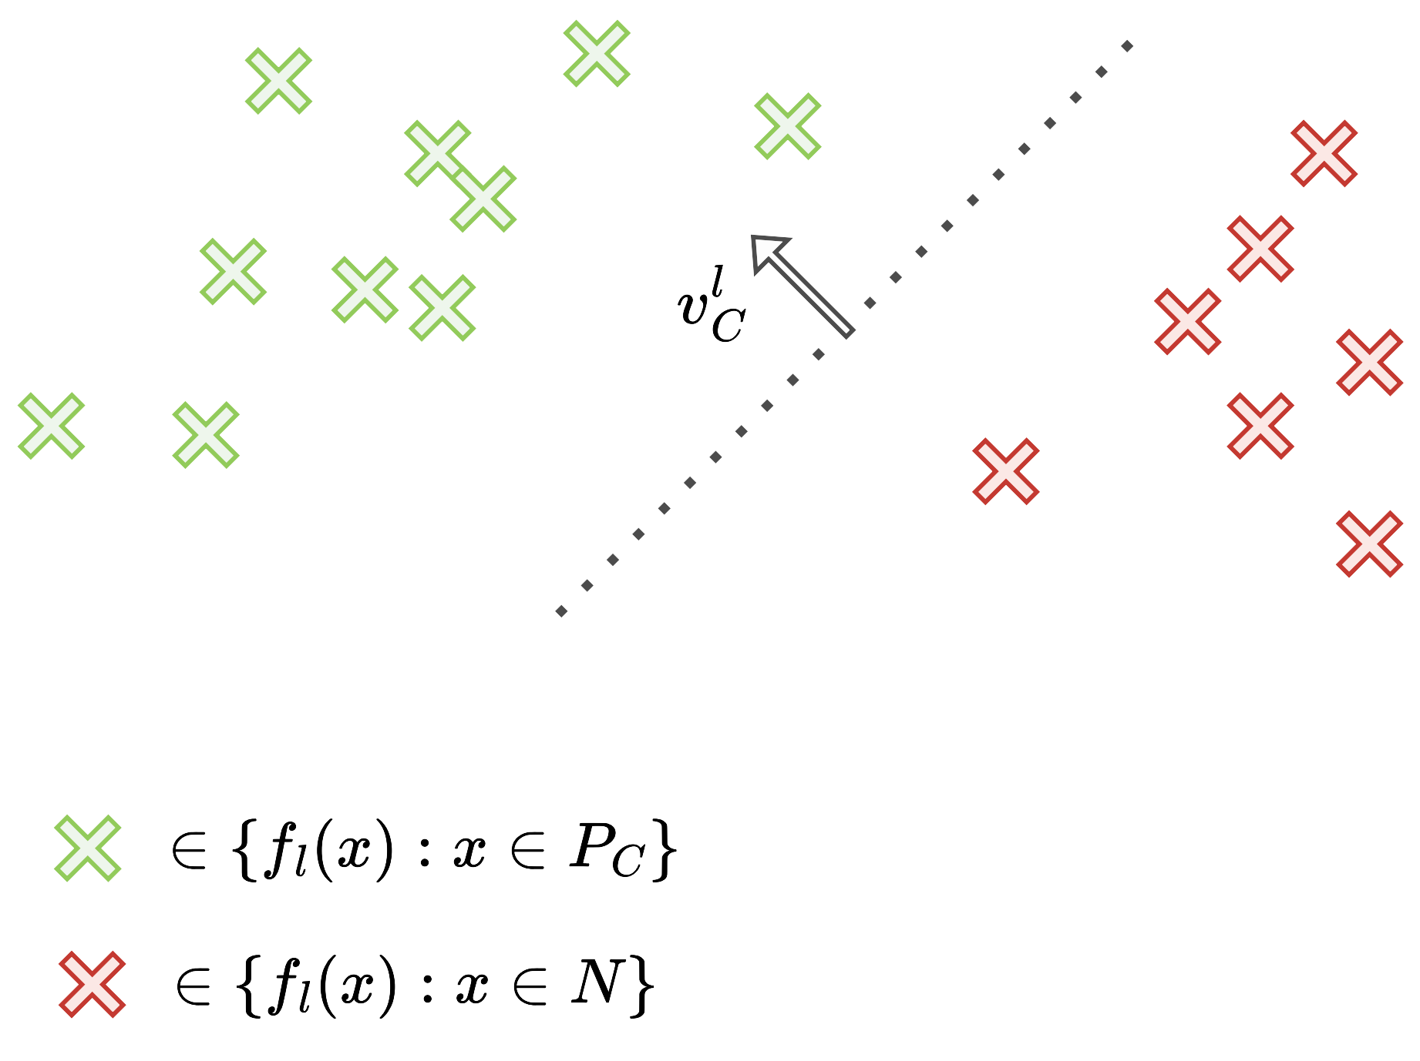
Approach: Visualizing the CAV
Stripes
Not stripes

Slide 12
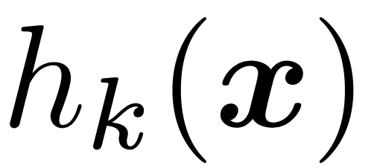
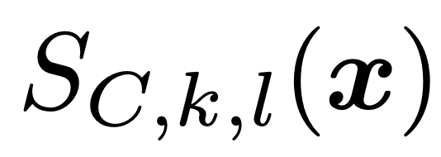
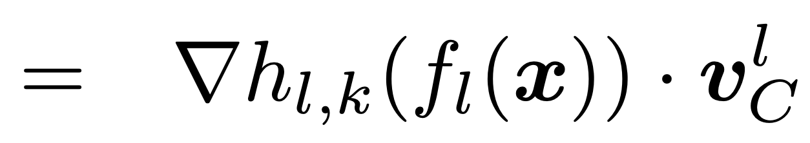
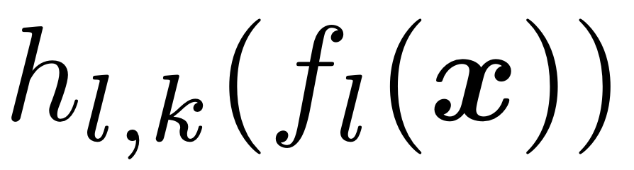
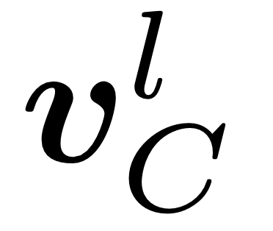
Approach: Gauging “concept sensitivity”
Saliency maps gauge sensitivity of predictions with respect to per-pixel perturbations
With CAV, we can gauge sensitivity of predictions towards a concept at an entire layer

Slide 13
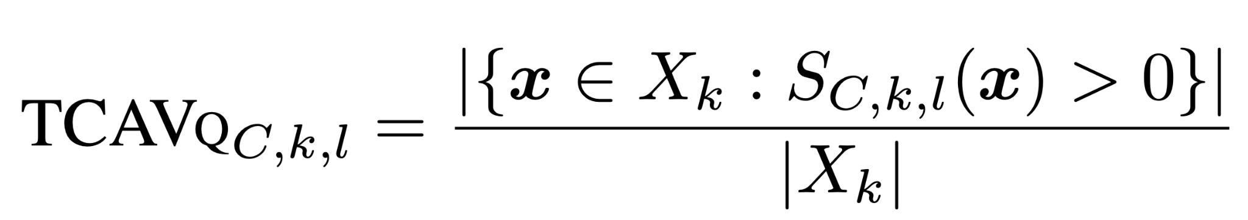
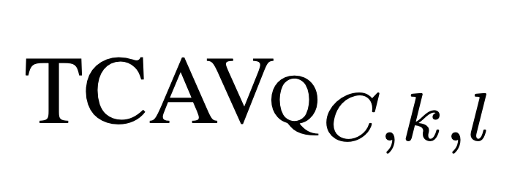
Approach: Testing with CAV (TCAV)
measures the fraction of inputs whose activations were influenced by a concept
This provides interpretation global to a particular class
A t-test can safeguard against meaningless CAVs

Slide 14
Approach Summary

Slide 15
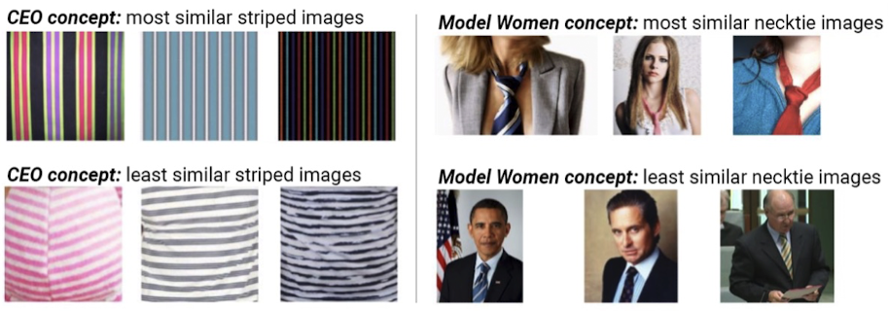
Results: Sorting Images with CAVs
Class: Stripes
Concept: CEO
Class: necktie
Concept: model woman
Confirmation that the CAVs correctly reflect the concept of interest
Sorting procedure can reveal biases used to learn the CAV

Slide 16
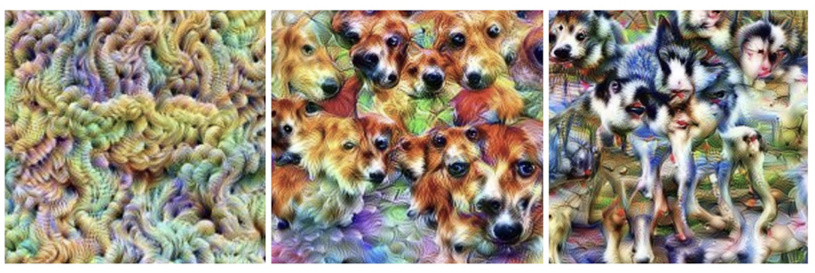
Results: Empirical Deep Dream
Deep Dream: visualizes patterns by maximizing activations
Deep Dream applied to a random image for three different CAVs
Knitted texture
Corgis
Siberian huskies
CAVs reflect their underlying concept

Slide 17
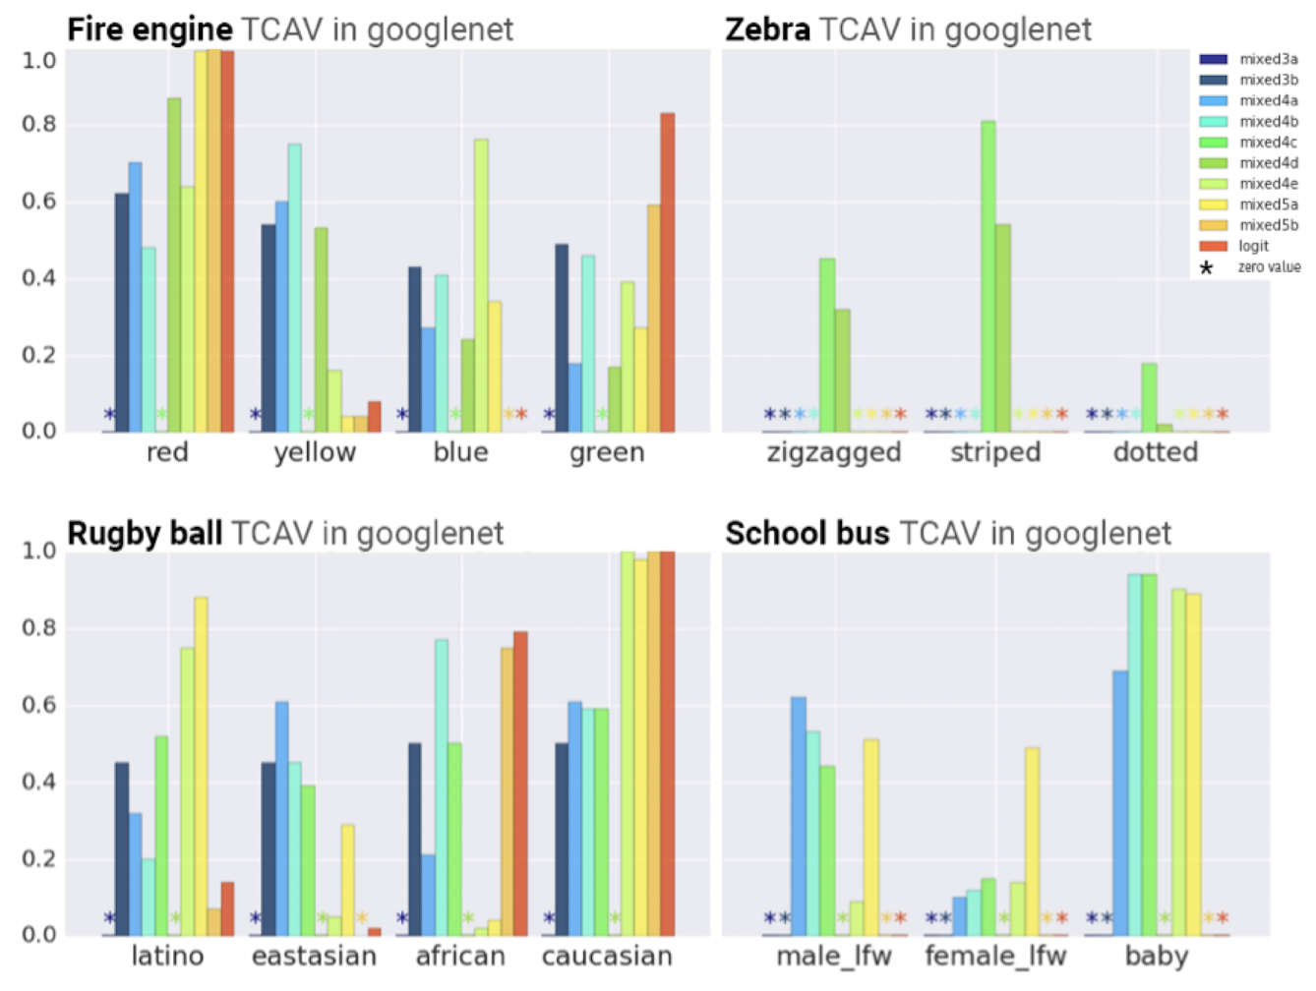
Results: Gaining Insights with TCAV
x-axis: CAV
y-axis: TCAV score = conceptual sensitivity of classification to concept
Each bar is a different layer of the NN with a statistically significant CAV
Layers closer to logit layer have a greater influence on the prediction
Matches intuition
“Red” is important for “fire engine”
“Striped” is important for “zebra”
Biases
“Caucasian” is important for “rugby ball”
Statistical significance test successfully removed spurious CAVS
“Dotted” is not important for “zebra”
Quantitatively confirm qualitative findings

Slide 18
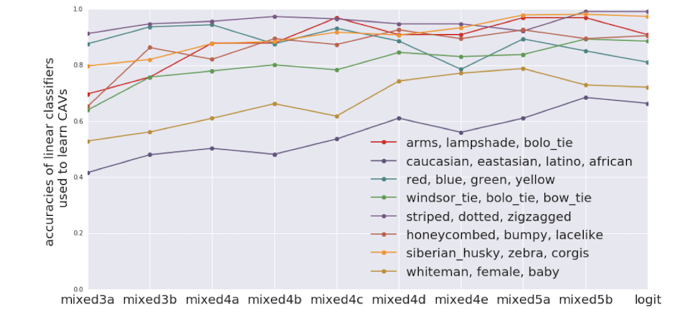
Results: TCAV for Where Concepts are Learned
Accuracies of different CAVs at different layers, showing where each concept is learned
Simple concepts (ex. colors, patterns) reach a high accuracy at low layers
Complex concepts (ex. age, sex, objects) don’t reach high accuracy until higher layers
Confirming past findings that lower layers = feature detectors and higher layers = classifiers
Notes:
Have the points appear one at a time - done

Slide 19
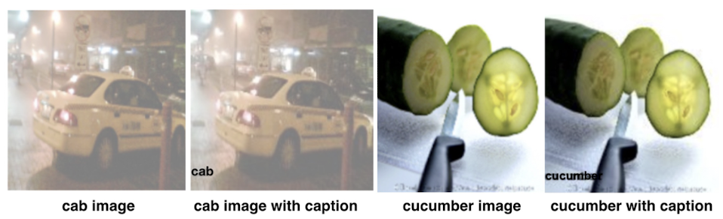
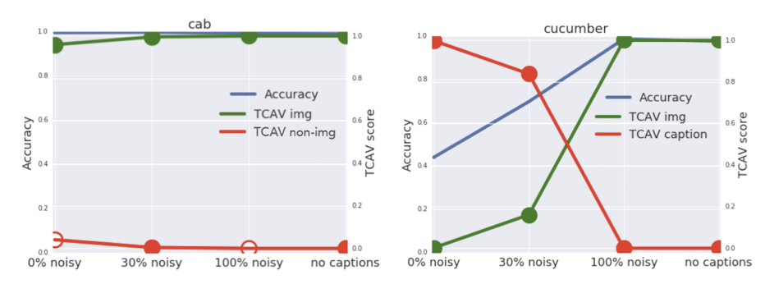
Results: Controlled Experiment with Ground Truth
Cab: image concept more important than caption concept regardless of noise
Cucumber: caption concept more important when caption is likely to appear
TCAV reflects ground-truth
Only image is important → high accuracy
Only caption is important → low accuracy
TCAV img → image concept CAV
TCAV non-img → caption concept CAV
Accuracy → tested on images without captions

Slide 20
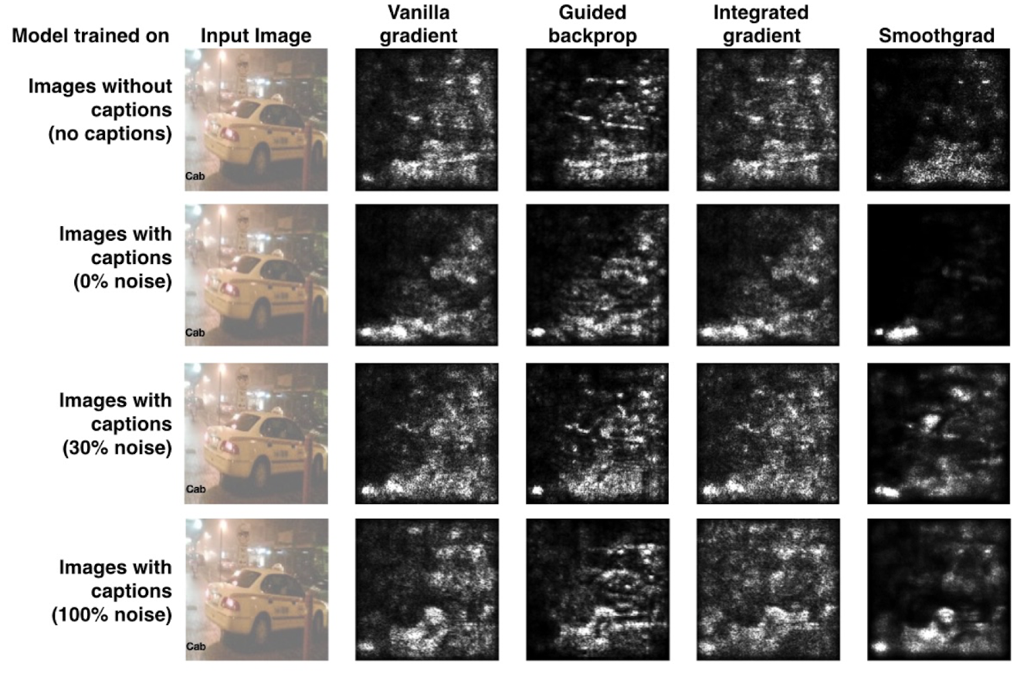
Results: Evaluation of Saliency Maps
Saliency map method
We know that for “cab” the “image” concept is most important, but this is not reflected in saliency maps → superiority of TCAV interpretability method

Slide 21
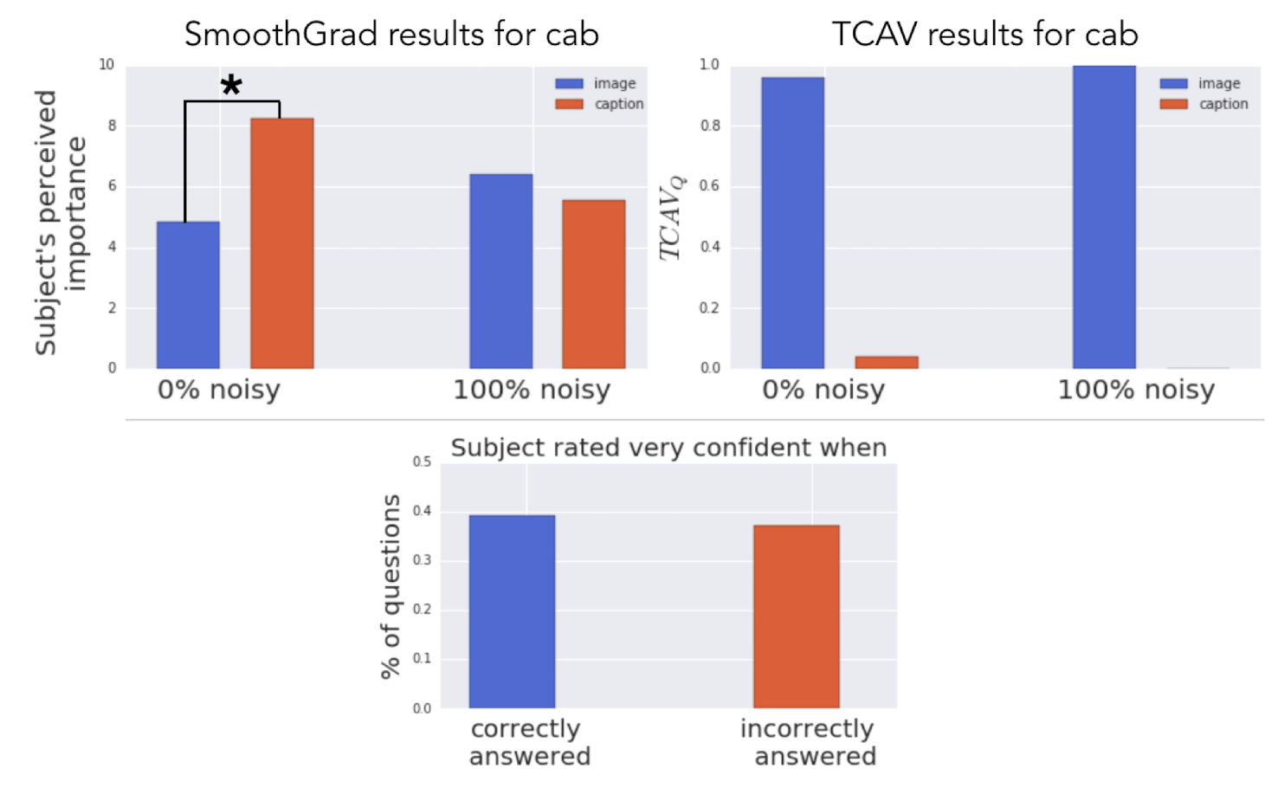
Results: Evaluation of Saliency Maps with Human Subjects
Subjects could not discern a difference in importance between the image and caption
Subjects incorrectly thought the caption was more important than the image
TCAV score correctly reflects which concept is most important
Saliency maps are misleading!

Slide 22
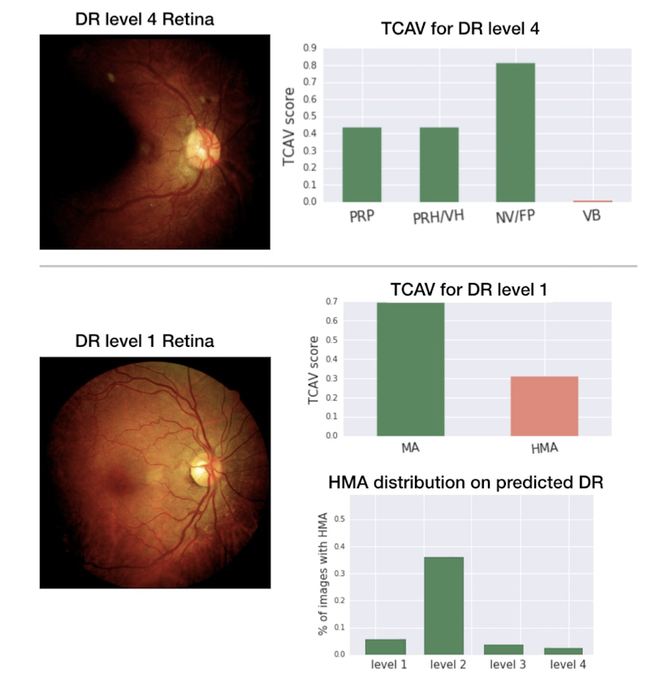
Results: TCAV for a Medical Application
Green = relevant concept Red = irrelevant concept
TCAV score shows model successfully distinguishes relevant and irrelevant concepts for level 4 diagnosis
TCAV score shows model is giving too much importance to HMA concept for level 1 diagnosis; HMA is relevant to level 2 not level 1 → use this to debug model

Slide 23
Conclusions
Roadmap: Gradient → Attention → Concept based approaches (TCAV!)
Limitations
Evaluated only on computer vision tasks
Statistical significance testing — is this rigorous?
Notes:
Where is approach likely to falter
Limitations of method and experimental setup

Slide 24
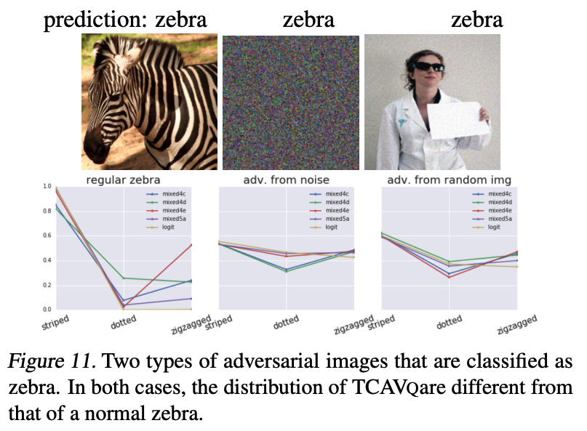
Discussion Questions
How does this method compare to e.g., saliency maps?
How would you adapt TCAV for other types of data (e.g., audio/video) and what would that look like?
Thoughts on TCAV for adversarial example identification (Appendix A)?
Do you think there could be adversarial images that allow meaningless CAVs to pass the statistical significance test?
Notes:
TCAV itself can be viewed a little like a feature attribution method. Is it deceptive too? Or are there reasons why it wouldn't be?

Slide 25
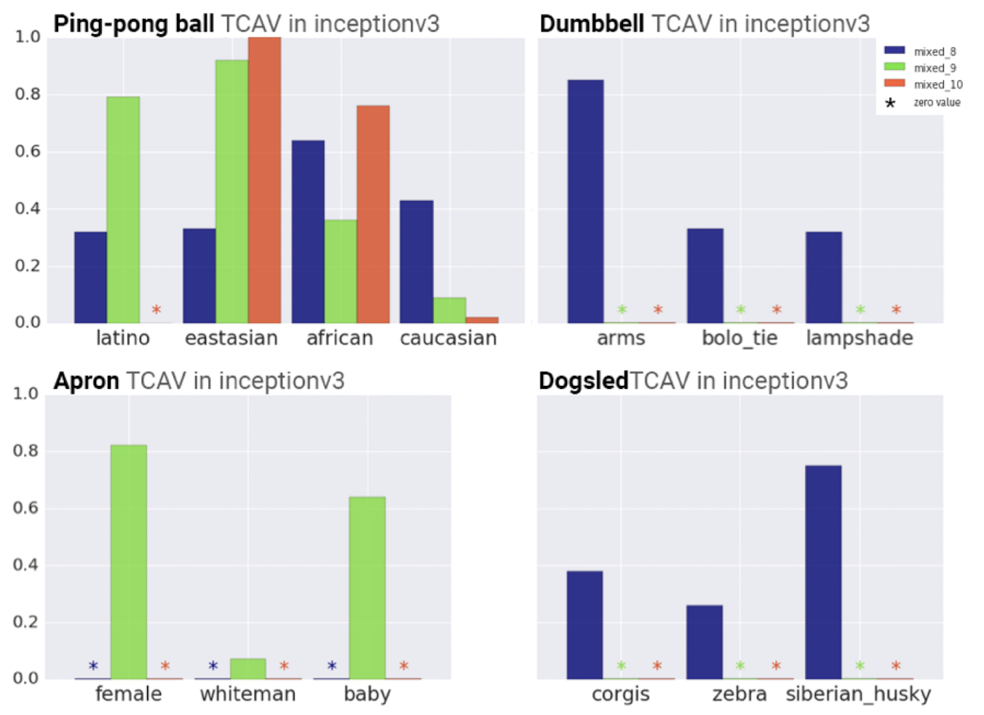
Results: Gaining Insights with TCAV
Each bar is a different layer of the NN

